Slide 1
Anomaly Detection on Model Performance
Intuit AI Executive Dashboard

Slide 2
Context
My team develops an executive dashboard (link) to monitor projects’ return-on-investment
The data science community has a need of monitoring model performance to proactively identify risks
We are in process of developing a new KPI summary dashboard to monitor KPIs that are consistent across the org.

Slide 3
Motivation
Data scientists want to understand anomalies in model performance because they may be caused by
broken data pipelines or system issues
Unclean or problematic input data
This analysis paves way for a model performance monitoring service that alerts scientists about issues about in-production models and risks in data

Slide 4
Mockup for New KPI Dashboard

Slide 5
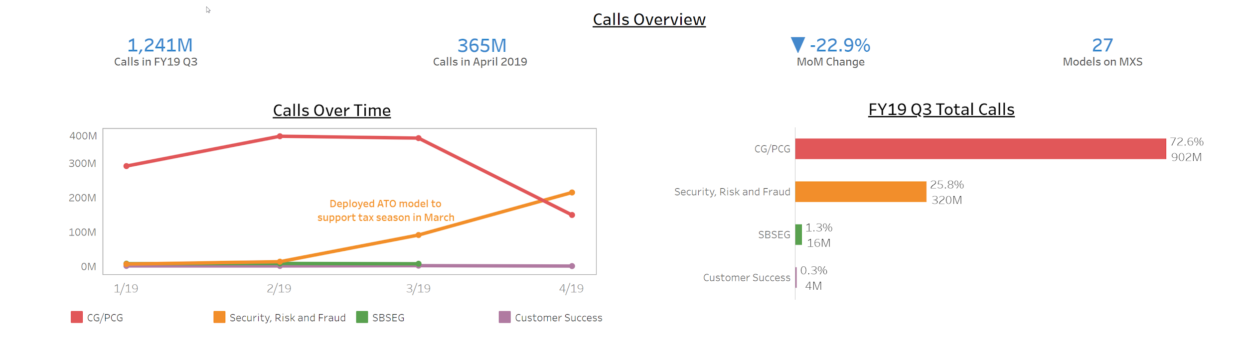
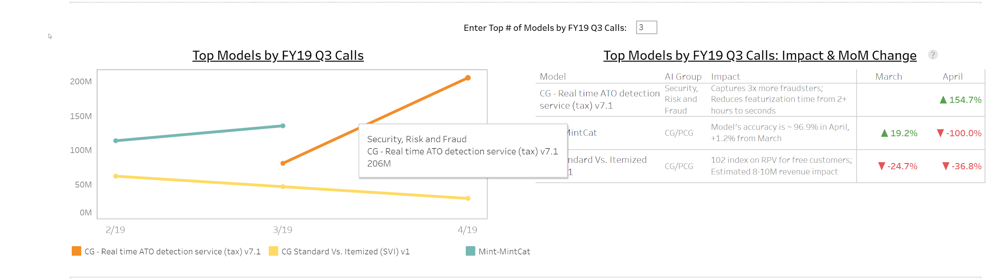
Intuit AI KPI: Model Usage, Performance & Impact
Technical Lead: Ashok Srivastava
PMO: Kavita Sangawan
Select Metric
MXS Calls
User Counts
Accuracy
Coverage
...
Select BU
CG/PCG
SBSEG
...
Select Product
QBO
...
Select Customers
IFDP
...
Select Time Period
Last Quarter
...
Select Region
US
...
Notes:
This is a mockup for a KPI page in the Intuit AI dashboard. The goal is to monitor and measure models’ usage and impact and to identify anomalies in model performance. It presents a view when the “MXS Calls” metric is selected.

Slide 6
Goal
The goal of this project is to learn and explore algorithms to detect anomalies in model performance in order to determine an algorithm to be implemented for a prototype dashboard

Slide 7
Approach
Time Series Analysis: ARIMA
Build ARIMA model on model performance time series
If an observation falls outside a 95% confidence interval around predictions, it is an anomaly
Isolation Forest
Isolate observations by recursively and randomly partitioning features
Classifies observations as anomalous or normal
Outputs anomaly scores
Anomaly score is a function of the number of splitings required to isolate observations
Anomaly score is a measure of normality

Slide 8
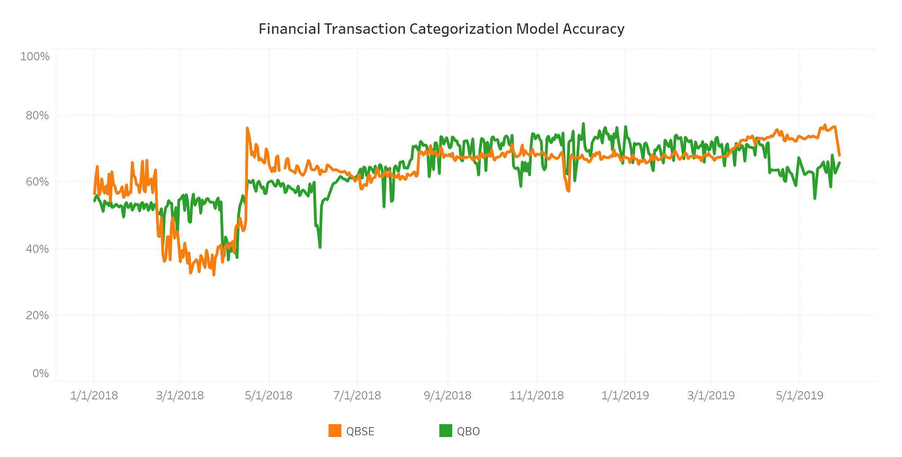
Data
IRIS models categorize bank transactions’ Chart-of-Account categories in QBO and QBSE
The data sets are the IRIS models’ accuracy

Slide 9
Detect Anomalies in Model Accuracy with ARIMA

Slide 10
ARIMA Model Assumptions
Stationary of original time series: Constant mean and variance
Model residuals:
Zero autocorrelation
Normality
Constant mean and variance

Slide 11
ARIMA Model Procedure
Check data’s stationarity with visuals and test
Transform data if it is not stationary
Determine model’s order by examining ACF and PACF plots
Fit model
Conduct model diagnostics with residual analysis
Make predictions and construct confidence intervals

Slide 12
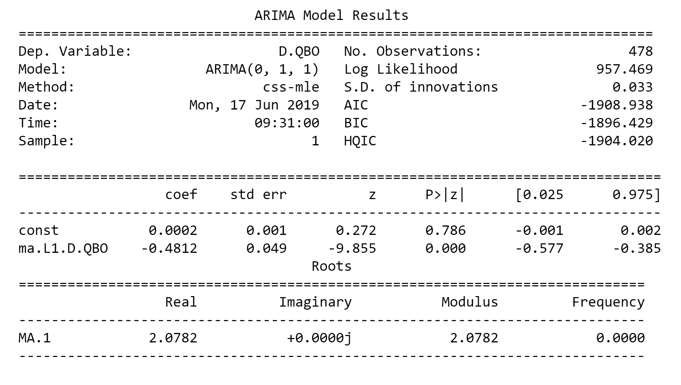
ARIMA Model Results

Slide 13
ARIMA Model Performance
Metric | Value
Mean Absolute Percentage Error | 0.09
Mean Error | 0.06
Mean Absolute Error | 0.06
Mean Percentage Error | 0.09
Root Mean Squared Error | 0.08

Slide 14
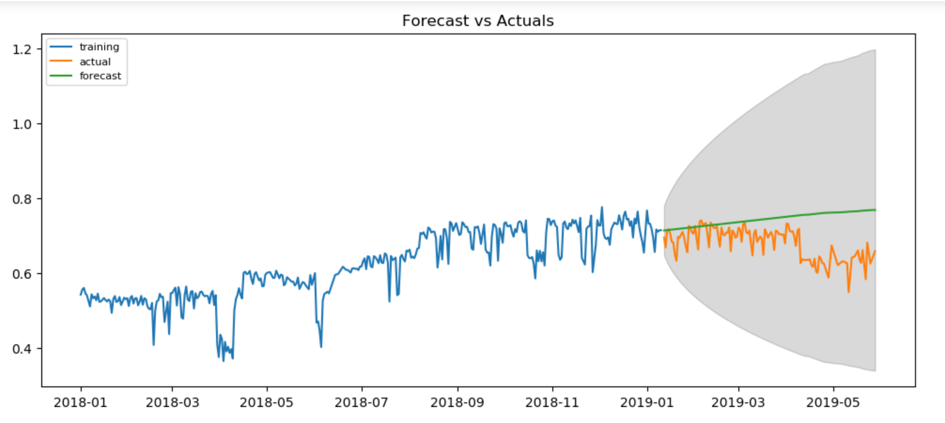
ARIMA Model Forecasts

Slide 15
Conclusions from ARIMA Model
No anomalies identified because no observations lie outside the confidence interval
Checking multiple assumptions and recursiviely fitting models may be time-consuming, so it may not be scalable

Slide 16
Detect Anomalies in Model Accuracy with Isolation Forest

Slide 17
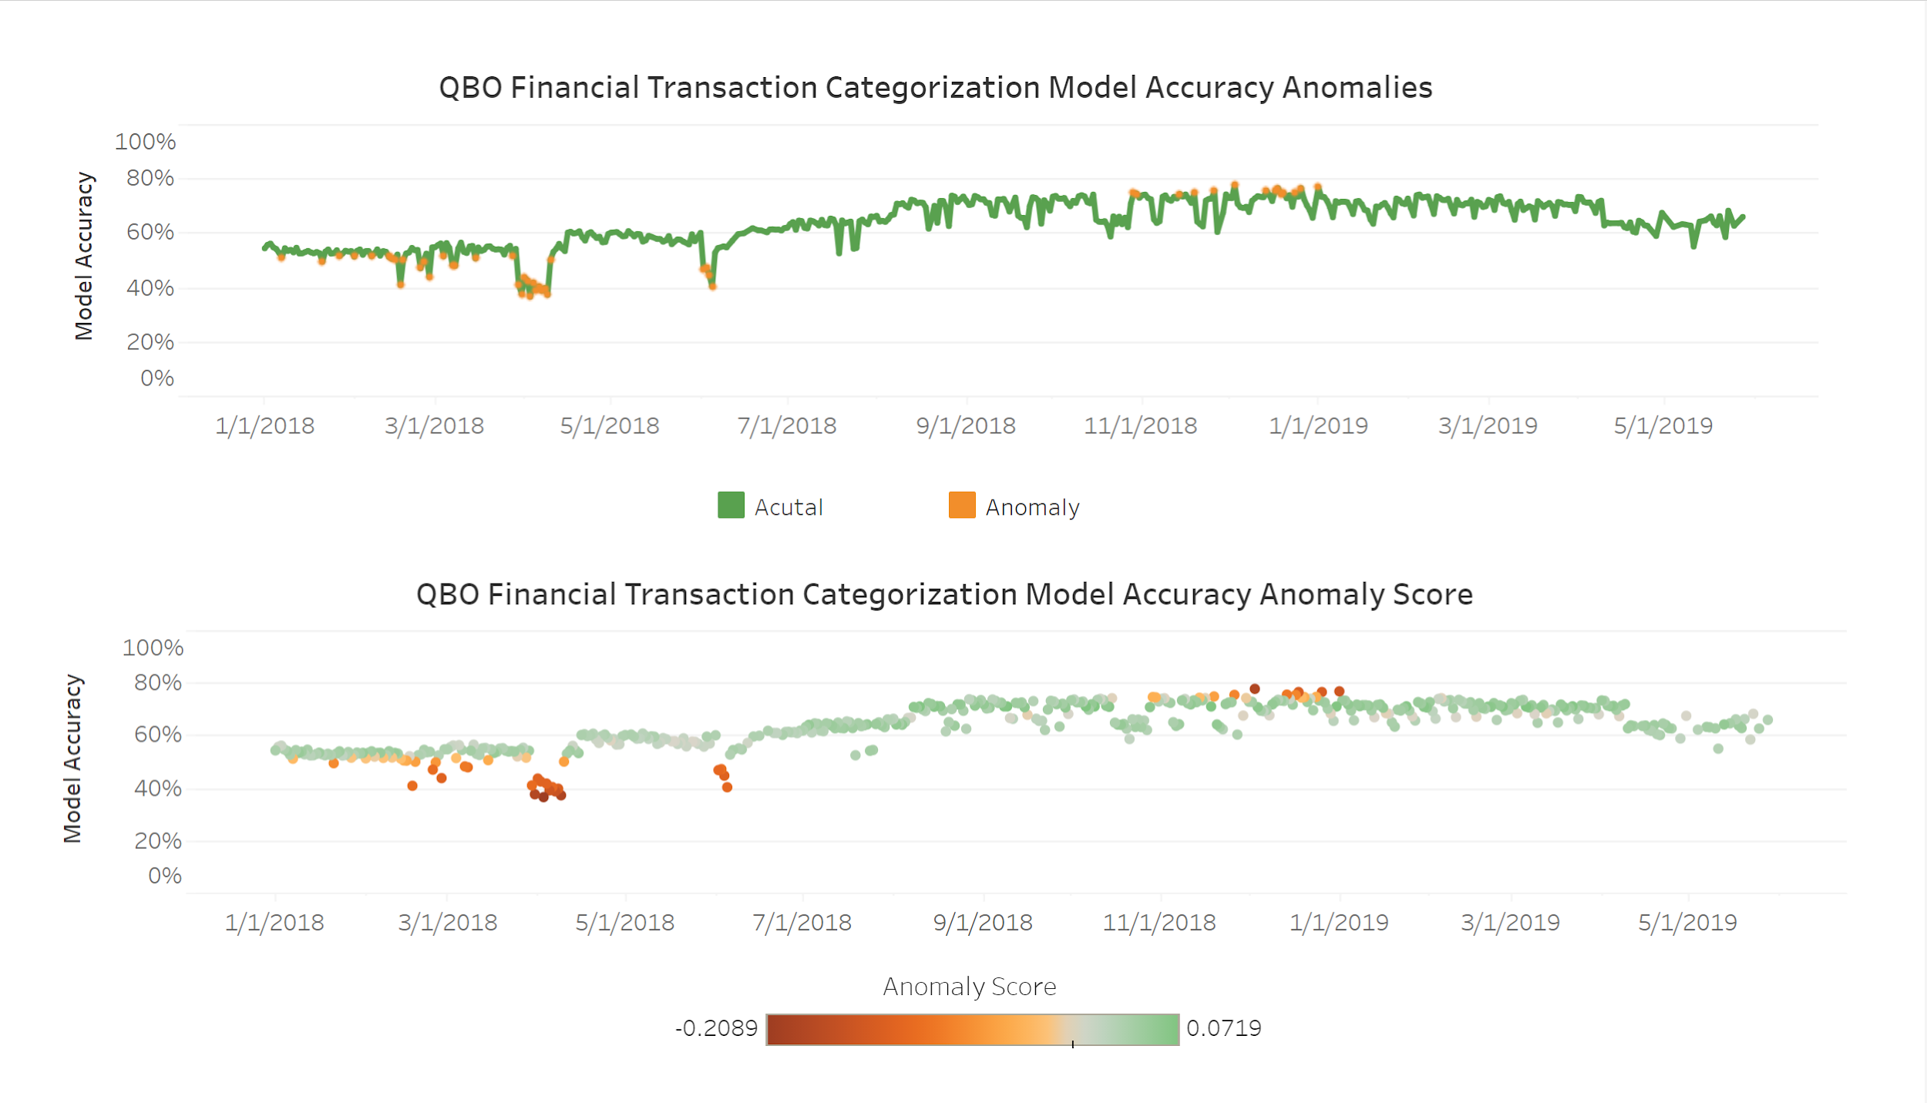

Slide 18
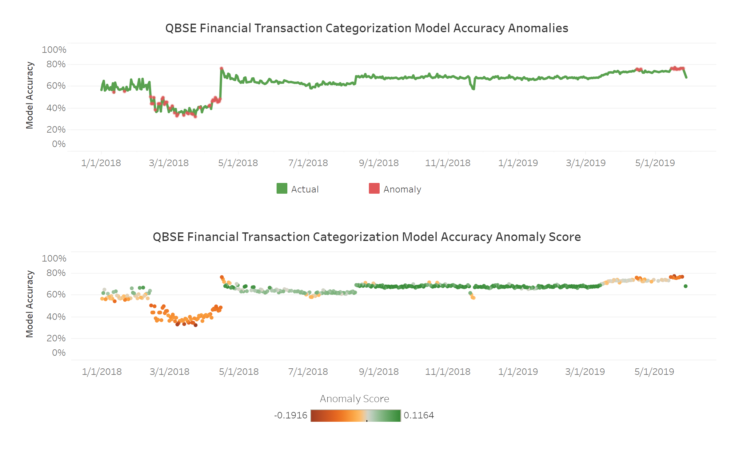

Slide 19
Explanations about Anomalies
1. Integration issues between model prediction and a categorization service (which some of the legacy systems overrides IRIS predictions)
2. Deduplications of a table was not well understood that time period
3. The most important reason is that IRIS was turned off by accident at the time period

Slide 20
Recommendations
Implement Isolation Forest algorithm to detect anomalies in model performance for in-production models for the dashboard because it is efficient and have no assumptions

Slide 21
Next Steps
Apply an internal anomaly detection service called Sherlock to testing data for the dashboard
Implement a prototype dashboard with the algorithm
Learn other algorithms such as Local Outlier Factor algorithm and Finite Rank Deep Kernel Learning

Slide 22
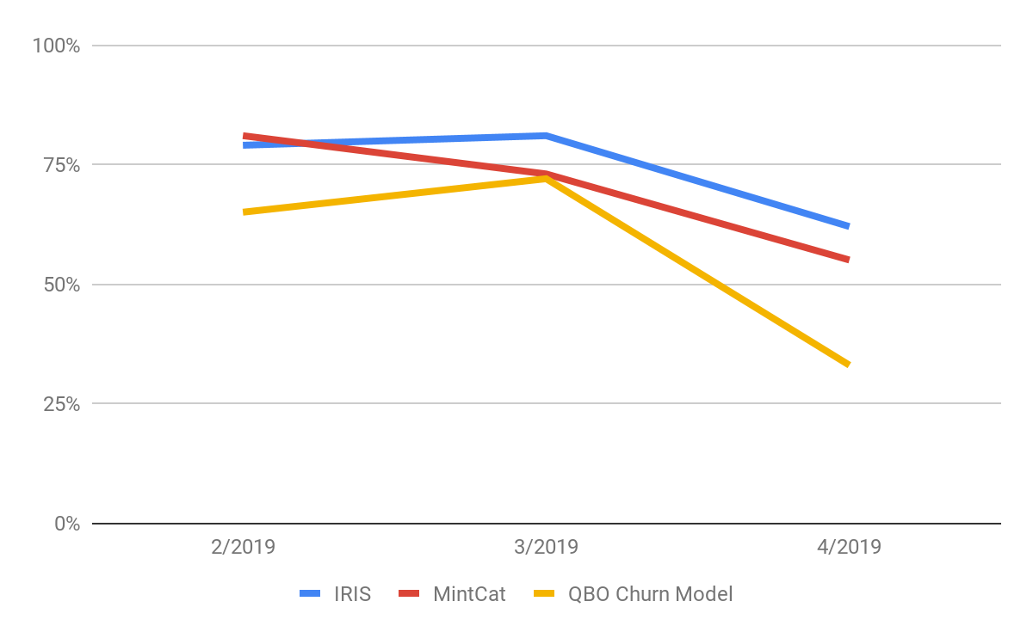
Intuit AI KPI: Model Usage, Performance & Impact
Technical Lead: Ashok Srivastava
Technical Lead: Ashok Srivastava
PMO: Kavita Sangawan
PMO: Kavita Sangawan
Select Metric
Accuracy Overview
MXS Calls
User Counts
Accuracy
Coverage
...
87%
Average Accuracy in FY19 Q3
79%
Average Accuracy in April 2019
- 12%
MoM Change
32
Models Measure Accuracy
Enter Top Models by Anomaly Score: 3
Select BU
Anomaly Summary
CG/PCG
SBSEG
...
Model | April Accuracy | Anomaly Score | MoM Change: March | MoM Change: April
QBO Churn Model | 33% | -2 | 11% | -54%
IRIS | 62% | -1.5 | 3% | -23%
MintCat | 55% | -1 | -10% | -10%
Select Product
QBO
...
Select Customers
Anomalous Model Accuracy
IFDP
...
Select Time Period
Last Quarter
...
Select Region
US
...
Notes:
This is a mockup for a KPI page in the Intuit AI dashboard. The goal is to monitor and measure models’ usage and impact and to identify anomalies in model performance. The left section has filters. It presents a view when the “Accuracy” metric is selected and user enters “3” for the “Enter Top Models by Anomaly Score” input box. The top 3 models with the highest anomaly scores in accuracy data are displayed in a line graph and table. The anomaly scores are calculated by Isolation Forest algorithm.

